Slide 1
More R (using sas data)

Slide 2
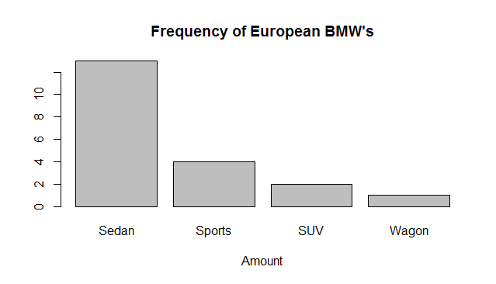
library(MicrosoftR)
data<-rxImport("c://cars.sas7bdat")
print(data)
?`RevoScaleR-package`
library(R2)
#number of Asian cars with rear drivetrain
nrow(data[data['Origin']=='Asia'&data['DriveTrain']=='Rear',])
#average horsepower for european cars
mean(data[data['Origin']=='Europe','Horsepower'])
#average price of US car
mean(data[data['Origin']=='USA','MSRP'])
#region with best price horsepower ratio
data['SBHP']<-data['MSRP']/data['Horsepower']
data[data['SBHP']==min(data['SBHP']),]
#some graphs
mikie<-table(data[data['Make']=='BMW','Type'])
print(mikie)
print(mtcars)
barplot(mikie, main="Frequency of European BMW's",xlab="Amount")
print(data[data['Type']=='Sedan',])
makes<-unique(data[data['Type']=='Sedan','Make'])
#graph of sedan vs price
sedans$makes<-makes
prices<-c()
for(a in makes){
print(paste("Price of " , a , " Sedan:" ,mean(data[data['Type']=='Sedan'&data['Make']==a,'MSRP'])))
prices<-c(prices,mean(data[data['Type']=='Sedan'&data['Make']==a,'MSRP']))
}
print(prices)
print(makes)
sedans<-c(prices,makes)
sedans = data.frame(makes,prices)

Slide 3
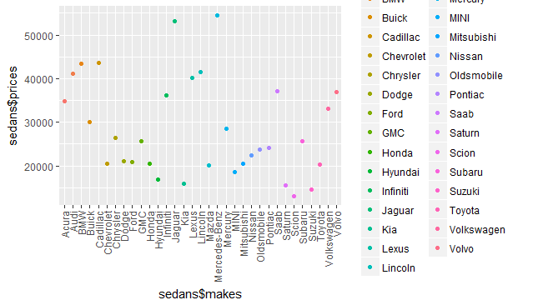
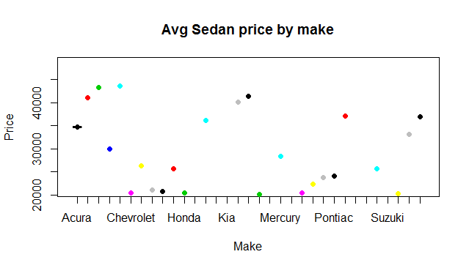
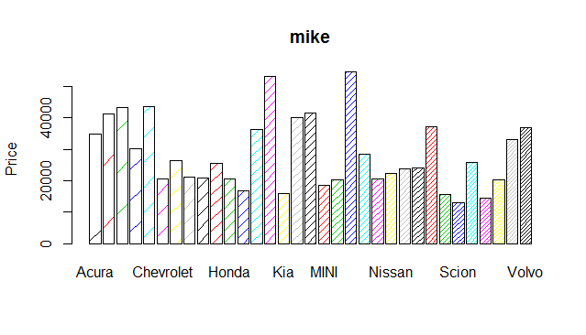
##Build scatter plot of sedan price by make. Scatter plot seems a poor way of representing this.
plot(sedans[1,1],sedans[1,2], main="Avg Sedan price by make",
xlab="Make", ylab="Price", pch=19, col='red')
par(xpd=FALSE)
for(i in 1:nrow(sedans)){
print(sedans[i,1])
#print(sedan[2])
points(sedans[i,1],sedans[i,2], pch=19, col=i)
}
par(xpd=TRUE)
#legend covers plot somewhat
legend(x=-10,y=70000,legend=makes,fill=1:nrow(sedans))
library(ggplot2)
##ggplot is a much better graph
ggplot(sedans, aes(y=sedans$prices, x=sedans$makes)) +
geom_point(aes(col=makes))+ theme(axis.text.x = element_text(angle = 90, hjust = 1, vjust = 0.5))
#bar plot of the prices
barplot(prices,main='mike',ylab='Price',names.arg=makes,col=1:nrow(sedans),density=1:nrow(sedans))
legend(x=-1,y=70000,legend=makes,fill=1:nrow(sedans),density=1:nrow(sedans))
print(sedans[1,2])

Slide 4
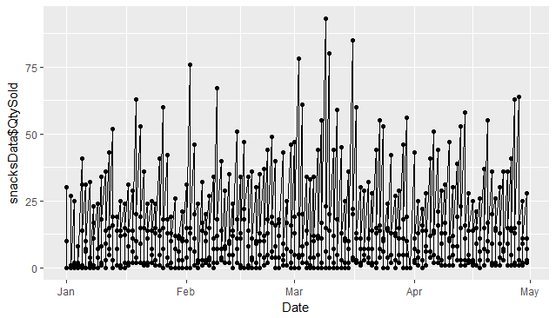
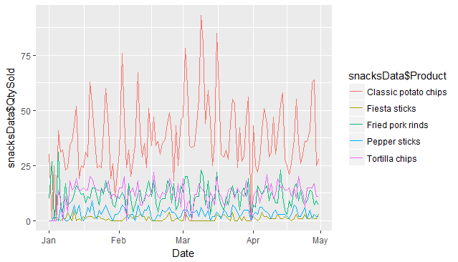
snacksData=rxImport("c://snacks.sas7bdat")
print(snacksData)
snacksData=subset(snacksData,snacksData$Date<'2002-05-01')
snacksData=subset(snacksData,snacksData$Product=='Classic potato chips'|
snacksData$Product=='Fiesta sticks'|
snacksData$Product=='Fried pork rinds' |
snacksData$Product=='Tortilla chips'|
snacksData$Product=='Pepper sticks'
)
ggplot(snacksData,aes(y=snacksData$QtySold,x=snacksData$Date))+geom_line()+geom_point()+xlab("Date")
#Best Graph here(Plot a line graph showing the quantity of each product sold over time. The graph should have a line for each product. Colour code as appropriate.):
ggplot(snacksData,aes(snacksData$Date,snacksData$QtySold))+geom_line(aes(col=snacksData$Product))+xlab("Date")+scale_x_date()
ggplot(snacksData,aes(y=snacksData$QtySold,x=snacksData$Date))+geom_line(position = 'jitter')+scale_x_discrete(labels = snacksData$Date) + xlab("Date")
#Plot a line graph showing sales for a
#particular product of your choice. Highlight the period that it was on sale in red,
#and off sale in blue. Alternatively, you can do the same but with the ‘advertised’ value instead.
potChips=subset(snacksData,snacksData$Product=='Classic potato chips')
potChipsSale=subset(snacksData,snacksData$Holiday==1)
potChipsNoSale=subset(snacksData,snacksData$Holiday==0)
nrow(potChipsNoSale)
print(potChipsSale)
ggplot(potChips,aes(potChips$Date,potChips$QtySold))+geom_line(aes(col=potChips$Holiday),show.legend = F)+scale_colour_gradientn(colours=c('blue','red'))
#as above but cummulative
ggplot(potChips,aes(potChips$Date,cumsum(potChips$QtySold)),title="Graph showing sales")+geom_line(aes(col=potChips$Holiday),show.legend = F)+scale_colour_gradientn(colours=c('blue','red'))+xlab("Date")+ylab("AmountSold")

Slide 5
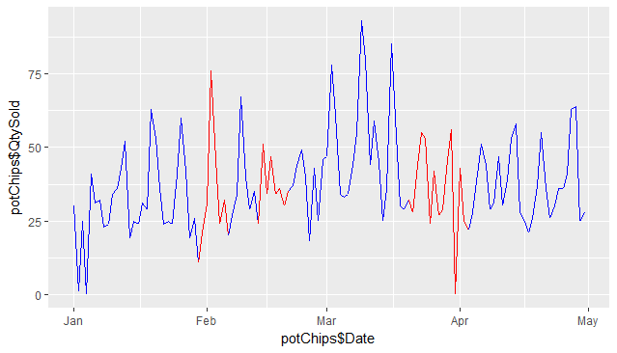
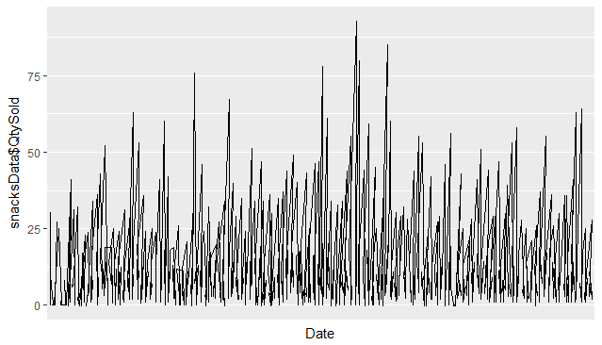
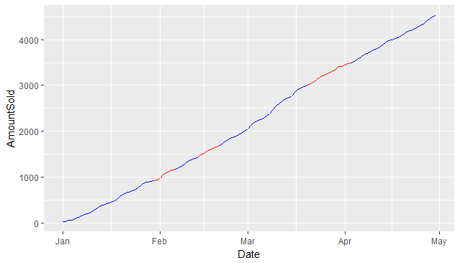

Slide 6
# Plot a 3D line graph of total sales (for all products) on the Z-axis,
#relative to the day and month (x and y axes). You may need to preprocess
#some of the data to enable this.
ggplot(snacksData,aes(snacksData$Price,snacksData$QtySold,snacksData$Product))+geom_line()
library(fmsb)
#Use the cars dataset to product a radar graph showing the relationship
#between horsepower, MSRP (with an inverted scale),
#invoice (inverted scale), engine size, cylinders.
print(data)
carstuff<-data.frame(data['Horsepower'],data['MSRP'],data['Invoice'],data['EngineSize'],data['Cylinders'])
carstuff=subset(carstuff,data['Origin']=='Europe')
radarchart(carstuff,axistype=2, pcol=topo.colors(3), plty=1, pdensity=c(5, 10, 30),
pangle=c(10, 45, 120), pfcol=topo.colors(3),
title="(topo.colors, fill, axis=2)")

